Slide 1
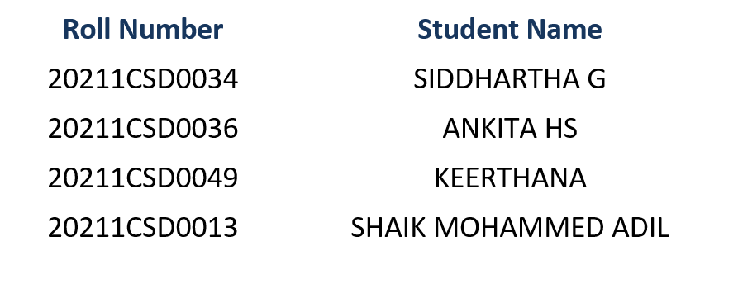
PIP4004 University Project
VIVA-VOCA
Sentiment Analysis of Incoming calls on helpdesk
Batch Number:CSD-12
Under the Supervision of,
Mr. Yamanappa
Assistant Professor
School of Computer Science and Engineering
Presidency University
Name of the Program: B.Tech
Name of the HoD: Dr. Saira Banu Atham
Name of the Program Project Coordinator: Dr. Manjula H M
Name of the School Project Coordinators: Dr. Sampath A K / Dr. Abdul Khadar A / Mr. Md Ziaur Rahman

Slide 2
Introduction
Understanding customer sentiment is essential for improving service quality in today’s customer-driven market.
The Call Sentiment Analysis System utilizes speech recognition and natural language processing (NLP) to analyze customer interactions.
It transcribes customer calls and classifies sentiment as positive, neutral, or negative.
The system is built using Python and Flask for efficient processing and deployment.
It records calls, converts speech into text, and stores sentiment insights in a database.
Businesses can assess customer satisfaction levels and identify service gaps using sentiment insights.
The system helps refine strategies by analyzing vocal tone and conversation context.
Enhances customer engagement and loyalty by providing valuable insights.
Aims to optimize service delivery and improve support efficiency.

Slide 3
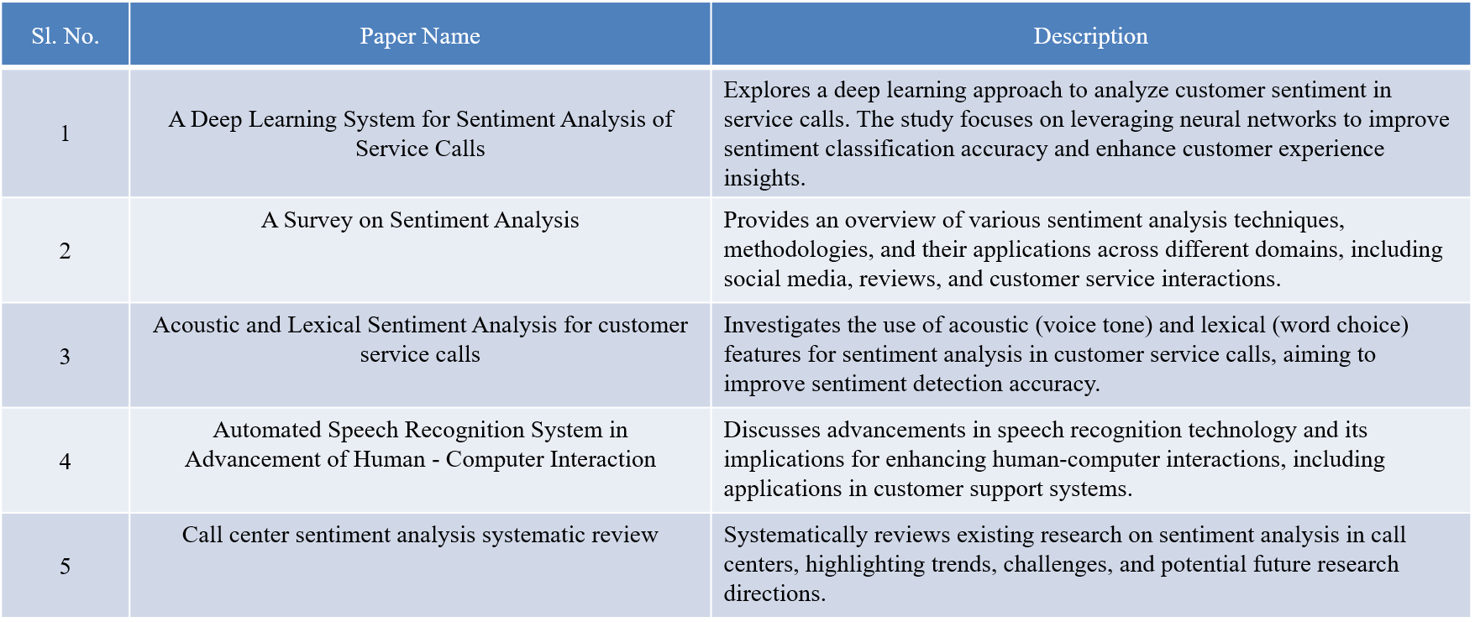
Literature Review

Slide 4
Research Gaps Identified
Personalization and Context–Aware Sentiment Detection
Demographic Bias in Sentiment Models
Data Privacy and Security
Fusion of Verbal and Nonverbal Cues
Ethical Challenges in Emotion Detection
Cost-Effectiveness and Accessibility

Slide 5
Proposed Method
Call Recording
Text Preprocessing
Speech to Text Transcription
Sentiment Analysis using NLP
Data Storage in CSV
Insights and Business Recommendations

Slide 6
Objectives
The objective of this project is to develop an intelligent system that integrates sentiment analysis and speech-based analysis to accurately interpret human emotions from both textual and vocal inputs. By leveraging natural language processing (NLP) techniques for sentiment analysis and speech recognition technologies for vocal tone and pattern analysis, the system aims to provide deeper insights into user emotions. This can be applied in various domains such as customer feedback evaluation, where businesses can assess customer satisfaction and detect dissatisfaction in both written and spoken reviews. Additionally, in virtual assistants and AI-driven communication systems, incorporating sentiment and speech analysis can enhance user interactions by enabling more empathetic and context-aware responses. Overall, this project aims to bridge the gap between textual and vocal emotion recognition, improving human-computer interactions and decision-making processes.

Slide 7
System Design and Implementation
System Architecture
Modular client-server setup using Kivy (GUI), PyTorch, Transformers (BERT), NLTK.
Client supports text/audio input; server handles transcription, NLP preprocessing, and sentiment prediction.
Core Functionalities
Live audio recording & file upload
Text preprocessing & transcription
Sentiment prediction (Positive, Negative, Neutral)
CSV logging with timestamps
Implementation Phases
Data cleaning & BERT training
Prediction service integration
GUI development with Kivy
Testing & evaluation

Slide 8
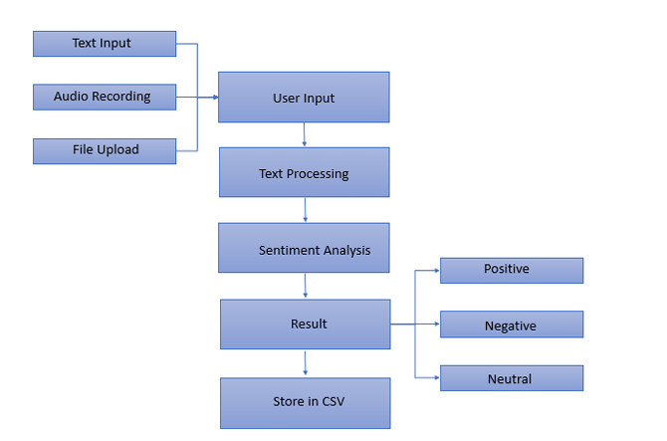
Architecture

Slide 9
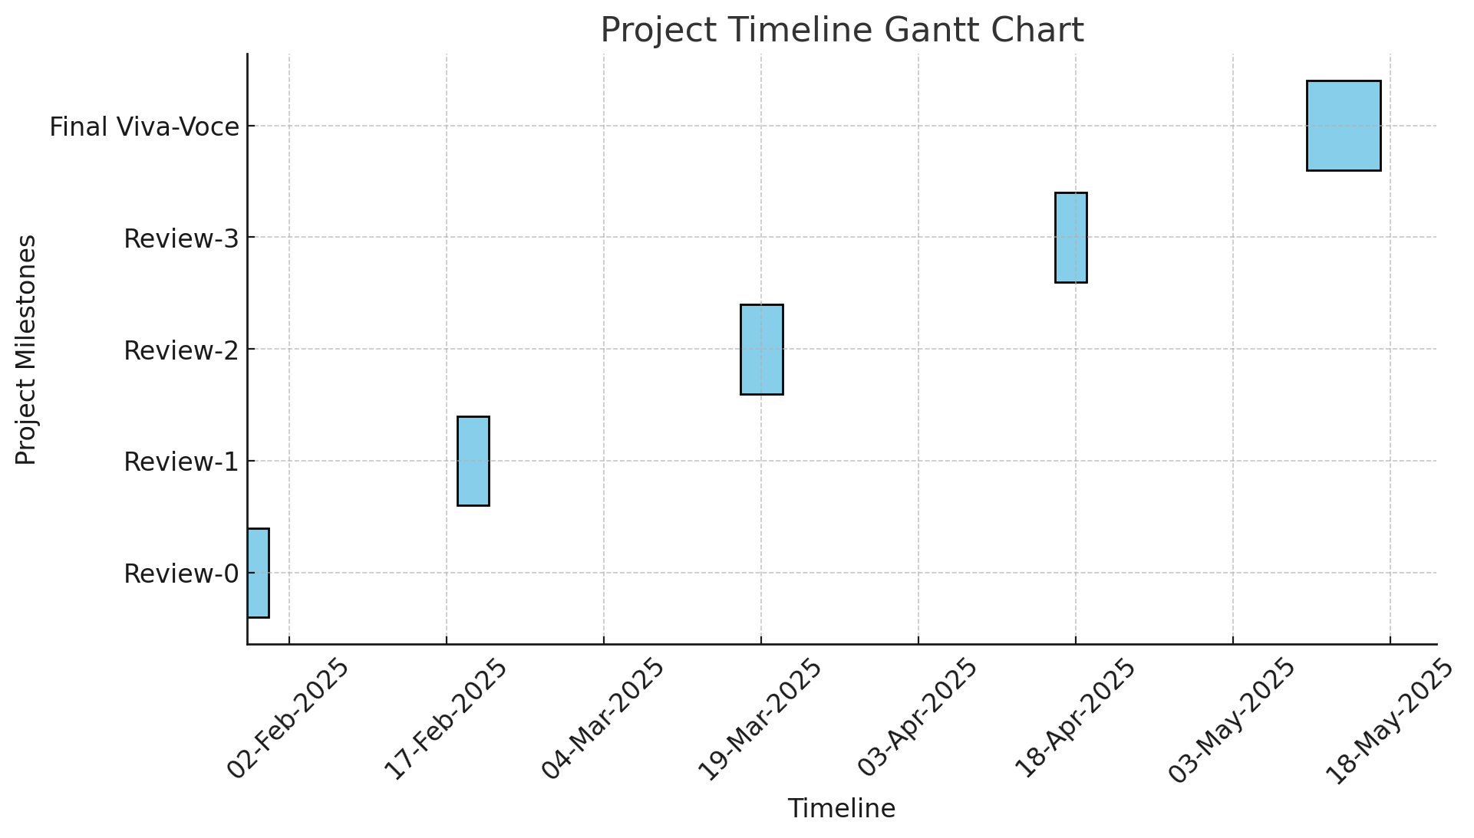
Timeline of Project

Slide 10
Outcomes Obtained
Improved Customer Understanding
Enhanced User Engagement
Effective Audio-to-Insight
Data – Driven Decision Making
Proactive Emotional Tracking
Customizable Integration Potential

Slide 11
Conclusion
This project represents a meaningful advancement in using AI to interpret and respond to human emotions through speech. By integrating audio input, speech transcription, and deep learning techniques such as BERT, it enables real-time sentiment analysis and enhances human-computer interaction in areas like mental health support, customer service, and personal well-being. The system’s user-friendly design includes features like live audio recording, instant sentiment prediction, and logging of emotional trends over time. These encourage self-awareness, reflection, and emotional tracking. As users recognize their emotional patterns, they are empowered to build healthier habits. This project is not just a tech innovation but a vital step toward developing emotionally intelligent systems that promote empathy and psychological well-being in our increasingly digital world.

Slide 12
GitHub Link
https://github.com/UniversityProject-CSD-12/Sentiment-Analysis-of-Incoming-calls-on-helpdesk

Slide 13
References
[1] A Deep Learning System for Sentiment Analysis of Service Calls (Yanan Jia, 2020)
[2] A Survey on Sentiment Analysis (R Raja Subramanian, 2021)
[3] Acoustic And Lexical Sentiment Analysis For Customer Service Calls (Bryan Li, 2019)
[4] Automated Speech Recognition System in Advancement of Human - Computer Interaction (Soumya Priyadarsini Panda, 2019)
[5] Call center sentiment analysis systematic review (K J Shrikrishna Narayana, 2023)
[6] Call Redistribution for a Call Center Based on Speech Emotion Recognition (Milana Bojani´c, 2020)
[7] Call-Type Classification And Unsupervised Training For The Call Center Domain (Min Tang, 2003)
[8] Emotion Recognition In Emergency Call Centers: The challenge of real-life emotions (Théo Deschamps-Berger, 2021)
[9] Ethics Sheet for Automatic Emotion Recognition and Sentiment Analysis (Saif M. Mohammad, 2022)
[10] Uday Exploring Sentiment Analysis Techniques in Natural Language Processing: A Comprehensive Review (Karthick Prasad Gunasekaran, 2023)

Slide 14
Publication Details
International Journal of Innovative Research in Computer and Communication Engineering (IJIRCCE) : Published

Slide 15


Project work mapping with SDG
The project described aligns with:
SDG 9: Innovation And Infrastructure
SDG 8: Good Jobs and Economic Growth

Slide 16
Thank You

